Slide 1

Sai Srikar Lab-6

Slide 2
PANTONE® COLOUR OF THE YEAR 2022
import numpy as np
import cv2 as cv
img = cv.imread('galaxy.jpeg',0)
cv.imshow("Original",img)
cv.waitKey(0)
cv.destroyAllWindows()
#Transalition
rows,cols = img.shape
M = np.float32([[1,0,100],[0,1,50]])
dst = cv.warpAffine(img,M,(cols,rows))
cv.imshow('Translation image',dst)
cv.waitKey(0)
cv.destroyAllWindows()
#Scaledimage
res = cv.resize(img,None,fx=2.75, fy=2.5, interpolation = cv.INTER_CUBIC)
cv.imshow("Scaled Image",res)
cv.waitKey(0)
cv.destroyAllWindows()

Slide 3
PANTONE® COLOUR OF THE YEAR 2022
#Rotation
dip= cv.getRotationMatrix2D(((cols-1)/2.0,(rows-1)/2.0),90,1)
rt= cv.warpAffine(img,dip,(cols,rows))
cv.imshow("Rotated Image",rt)
cv.waitKey(0)
cv.destroyAllWindows()
#shrinking and zooming
shrink = cv.resize(img,None,fx=0.25, fy=0.25, interpolation = cv.INTER_AREA)
cv.imshow("Shrinking",shrink)
cv.waitKey(0)
cv.destroyAllWindows()
zoom= cv.resize(img,None,fx=2, fy=2, interpolation = cv.INTER_LINEAR)
cv.imshow("Zooming",zoom)
cv.waitKey(0)
cv.destroyAllWindows()

Slide 4
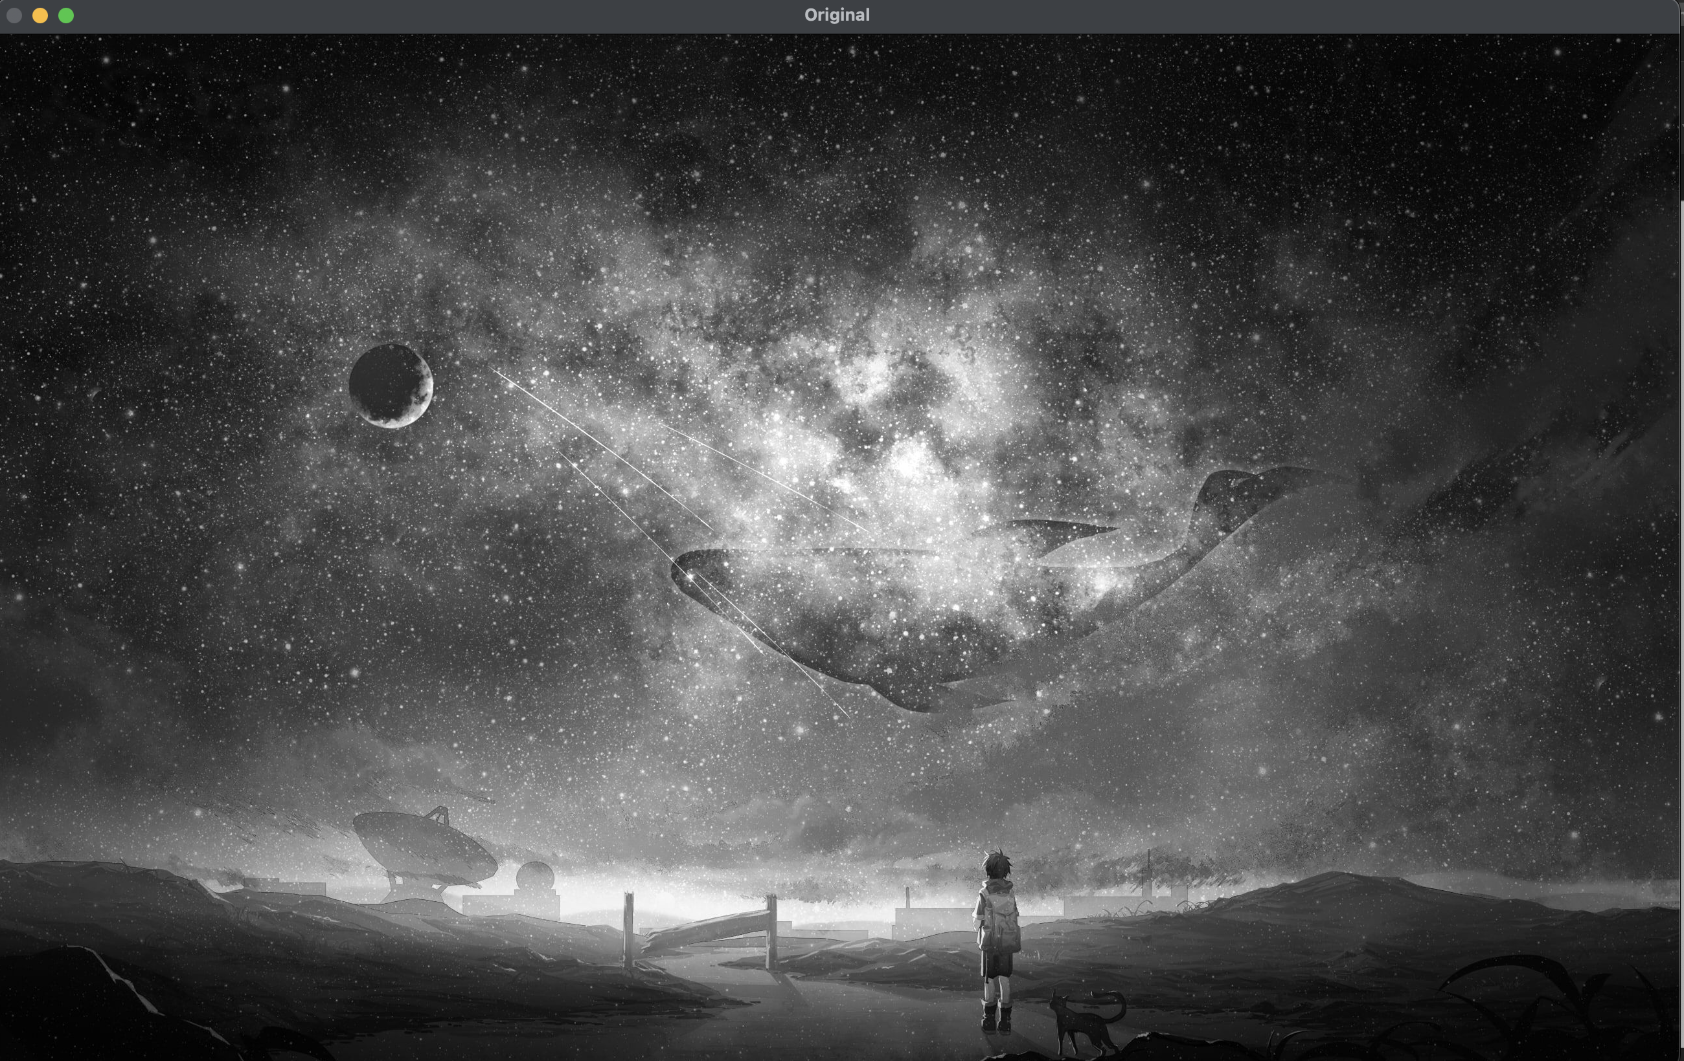
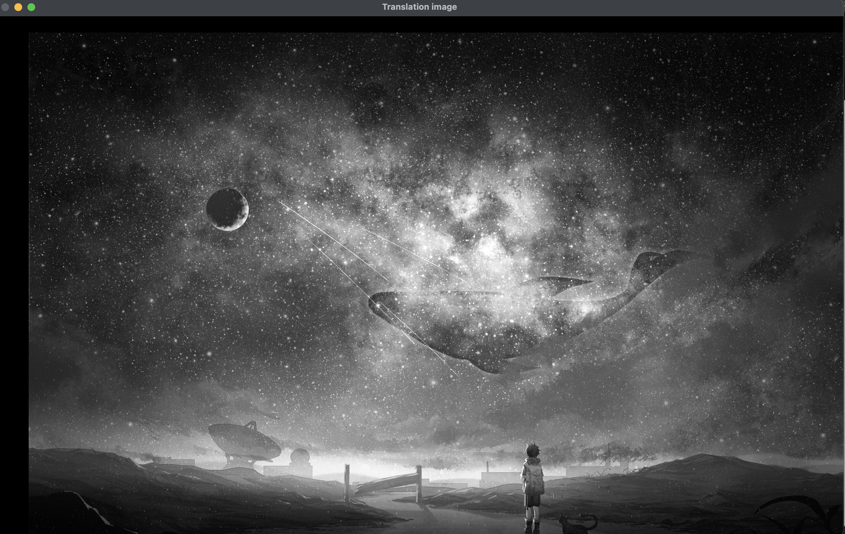
PANTONE® COLOUR OF THE YEAR 2022
OUTPUT-:

Slide 5
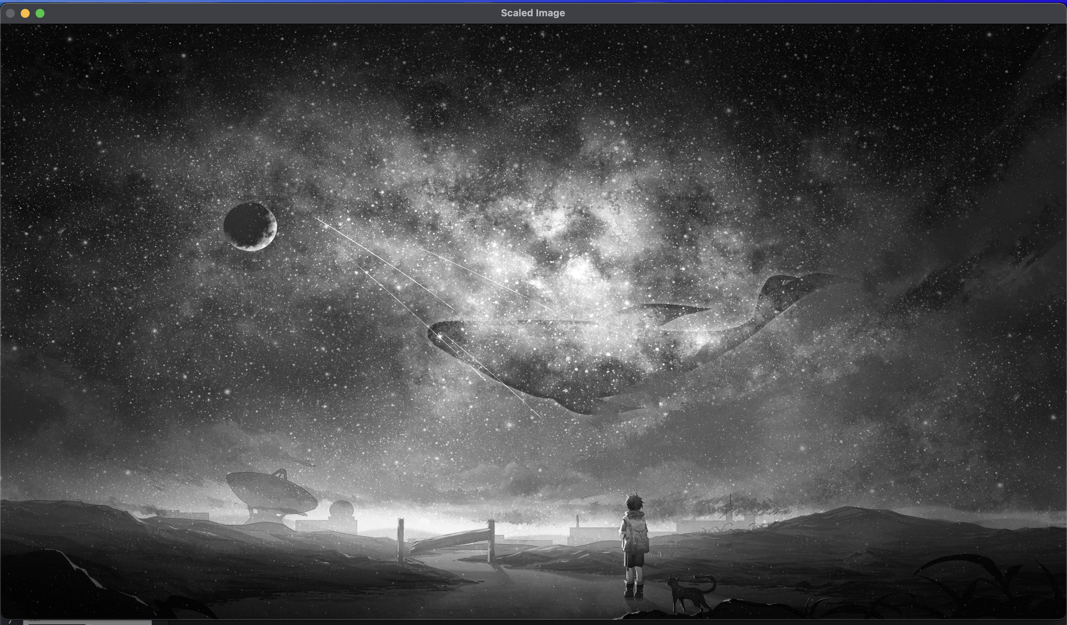
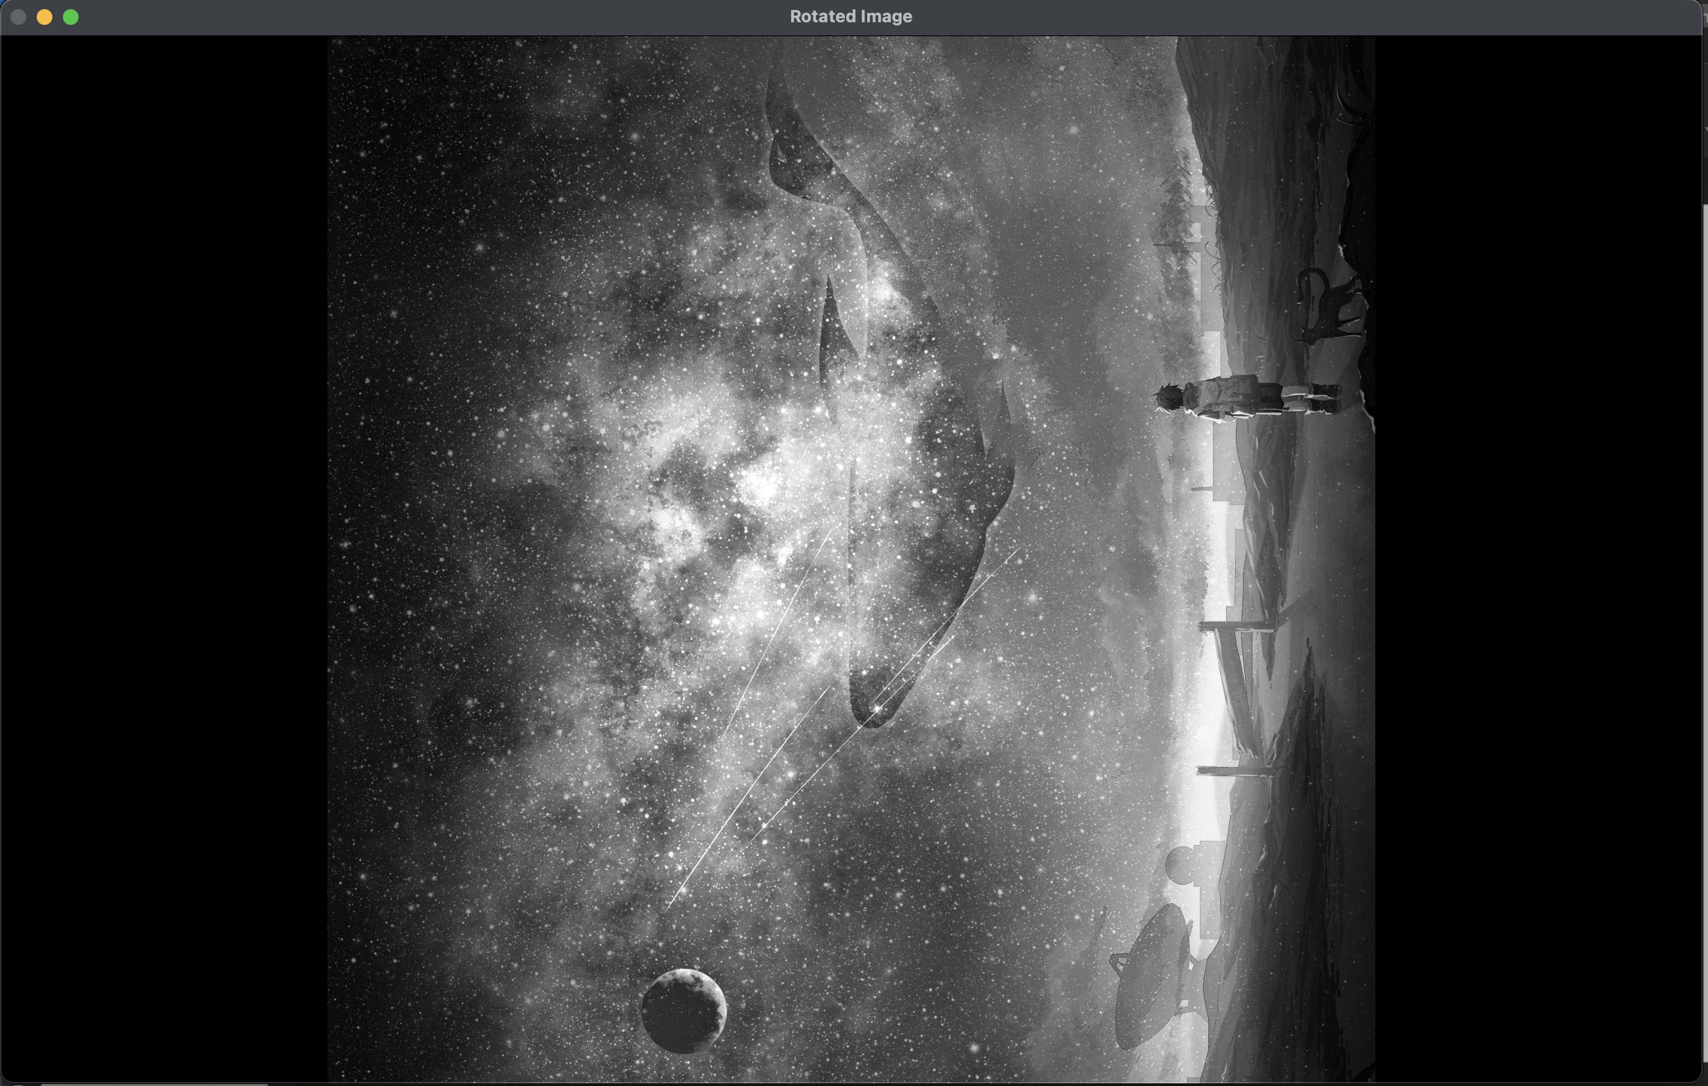
OUTPUT-:

Slide 6
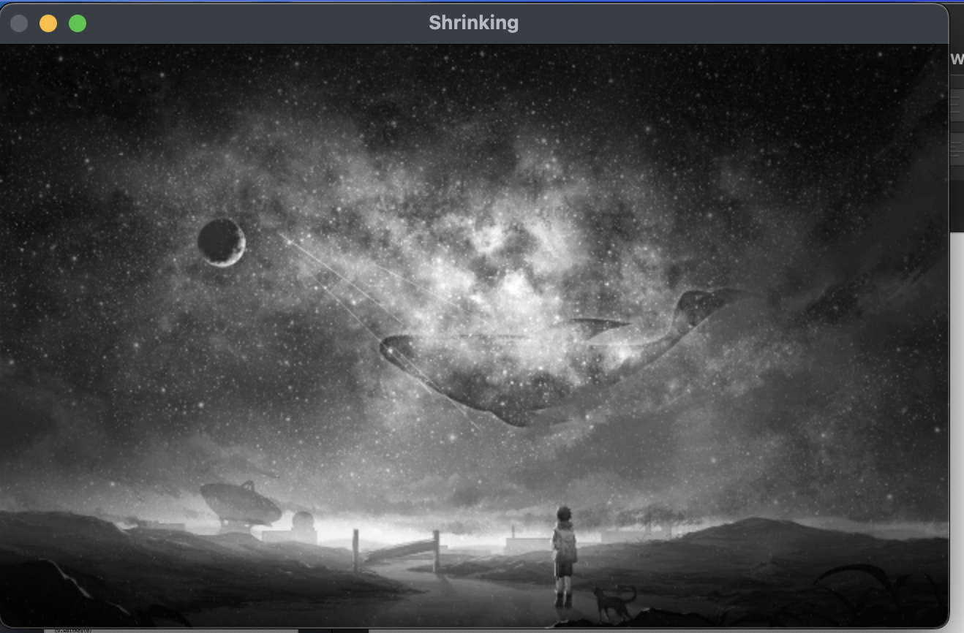
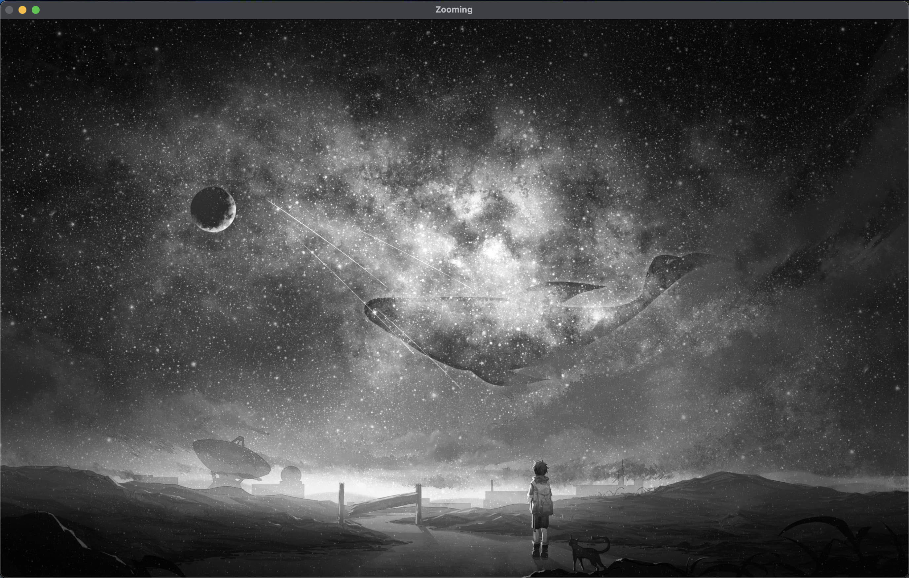
PANTONE® COLOUR OF THE YEAR 2022
OUTPUT-:

Slide 7
CONVOLUTION
Convolution is a good way to identify patterns in data that is directly tied to space or time. Adjacent pixels in an image are adjacent for a reason. In the physical world, they collect light from neighboring locations. Time series data has a similar structure. Neighboring data points were produced close together in time and are much more likely to be related then points far apart. This inherent structure is what convolution exploits. It finds local patterns that reoccur in the data. It would not be effective, for instance, if we first scrambled the pixels in an image. That would hide the patterns, the spatial relationships, that convolution tries to learn.
The recipe for convolution is surprisingly short:
Flip the kernel left to right
Step the kernel along the signal one data point at a time
At each position, calculate the dot product of the two
3.1 Multiply each pair of aligned values together
3.2 Add up those products
The resulting sequence of dot products is the convolution of the kernel with the signal
In 1D CNN, kernel moves in 1 direction. Input and output data of 1D CNN is 2 dimensional. Mostly used on Time-Series data. In 2D CNN, kernel moves in 2 directions and so on…

Slide 8
# Plotting a 1D convoluted graph
import numpy as np
import matplotlib.pyplot as plt
x = np.linspace(1,1000,80)
x1 = np.cos(x)**2
x2 = np.tanh(x)*(np.sin(x)**2)
print(x.shape, x1.shape, x2.shape) conv_1d = np.convolve(x1, x2) print(conv_1d.shape) plt.figure(figsize=(30,15)) plt.subplot(211)
plt.title("2 signals", fontsize = 10)
plt.plot(x, x1)
plt.plot(x, x2)
plt.subplot(212)
plt.title("1D Convoluted signal", fontsize =10)
plt.plot(conv_1d)
plt.show()

Slide 9
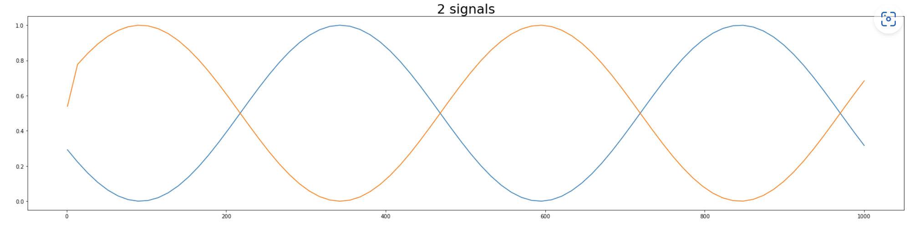
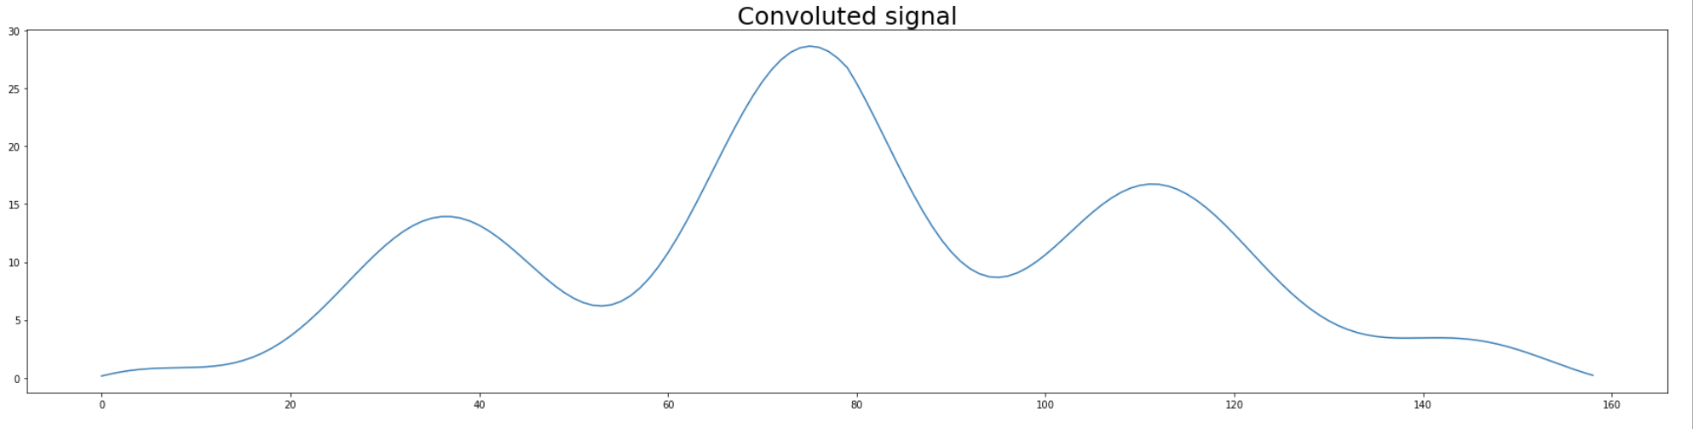
PANTON® COLOUR OF THE YEAR 2022
OUTPUT-:

Slide 10
PANTONE® COLOUR OF THE YEAR 2022
import cv2
import numpy as np
from scipy import ndimage
img = cv2.imread("galaxy.jpeg", 0)
cv2.imshow('Original Image', img)
cv2.waitKey(0)
cv2.destroyAllWindows()
# (1/9 3X3 K matrix) Low Pass Kernel
kernel_1 = np.ones((3,3), np.float32)/9
dst_1 = cv2.filter2D(img,-1, kernel_1)
cv2.imshow('Low pass Filters 1/9 3X3 K Matrix', dst_1)
cv2.waitKey(0)
cv2.destroyAllWindows()
# (1/5 3X3 K matrix) Low Pass Kernel
kernel_2 = np.ones((3,3), np.float32)/5
dst_2 = cv2.filter2D(img,-1, kernel_2)
cv2.imshow('Low pass Filters 1/5 3X3 K Matrix', dst_2)
cv2.waitKey(0)
cv2.destroyAllWindows()

Slide 11
PANTONE® COLOUR OF THE YEAR 2022
#(1/1 3X3 MATRIX) Low pass kernel
kernel_3 = np.ones((3,3), np.float32)/1
dst_3 = cv2.filter2D(img,-1, kernel_3)
cv2.imshow('Low pass Filters 1/1 3X3 K Matrix', dst_3)
cv2.waitKey(0)
cv2.destroyAllWindows()
# High Pass kernel (Middle Value 3)
kernel_3x3 = np.array(
[[-1, -1, -1],
[-1, 3, -1],
[-1, -1, -1]])
k3 = ndimage.convolve(img, kernel_3x3)
cv2.imshow('Original Image', img)
cv2.imshow('hpf 3', k3)
cv2.waitKey(0)
cv2.destroyAllWindows()

Slide 12
PANTONE® COLOUR OF THE YEAR 2022
# High Pass Kernel (Middle Value 5)
kernel_5 = np.array(
[[-1, -1, -1],
[-1, 5, -1],
[-1, -1, -1]])
k5 = ndimage.convolve(img, kernel_5)
cv2.imshow('Original Image', img)
cv2.imshow('hpf 5', k5)
cv2.waitKey(0)
cv2.destroyAllWindows()
# High Pass Kernel (Middle Value 9)
kernel_9 = np.array(
[[-1, -1, -1],
[-1, 9, -1],
[-1, -1, -1]])
k9 = ndimage.convolve(img, kernel_9)
cv2.imshow('Original Image', img)
cv2.imshow('hpf 9', k9)
cv2.waitKey(0)
cv2.destroyAllWindows()

Slide 13
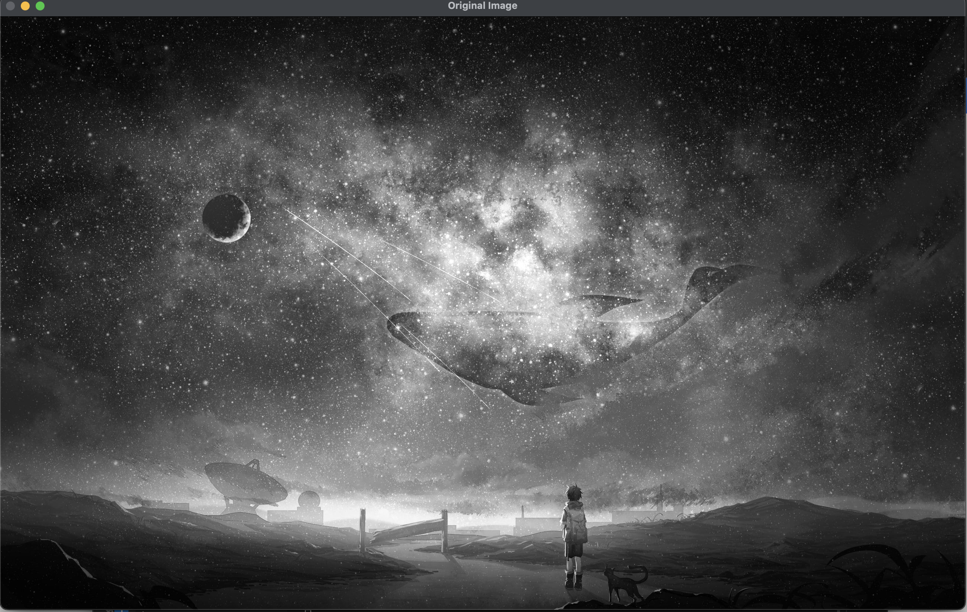
OUTPUT-:

Slide 14
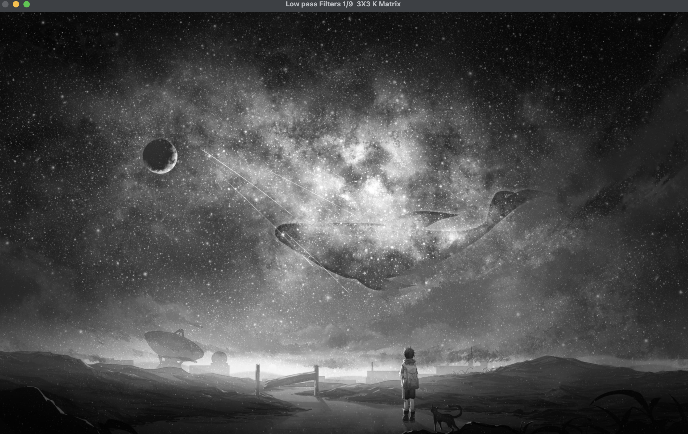
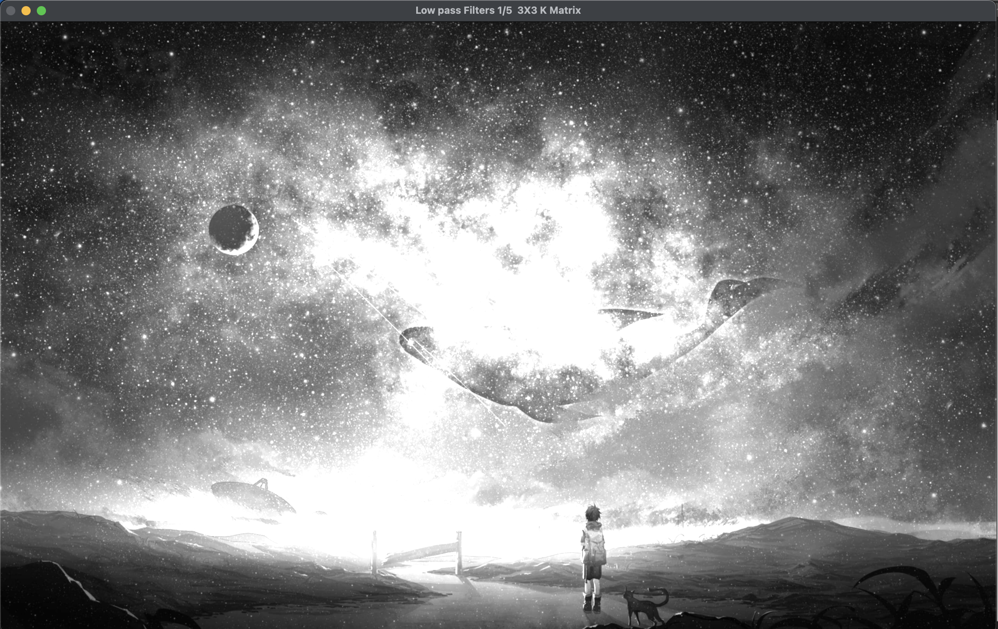
OUTPUT-:

Slide 15
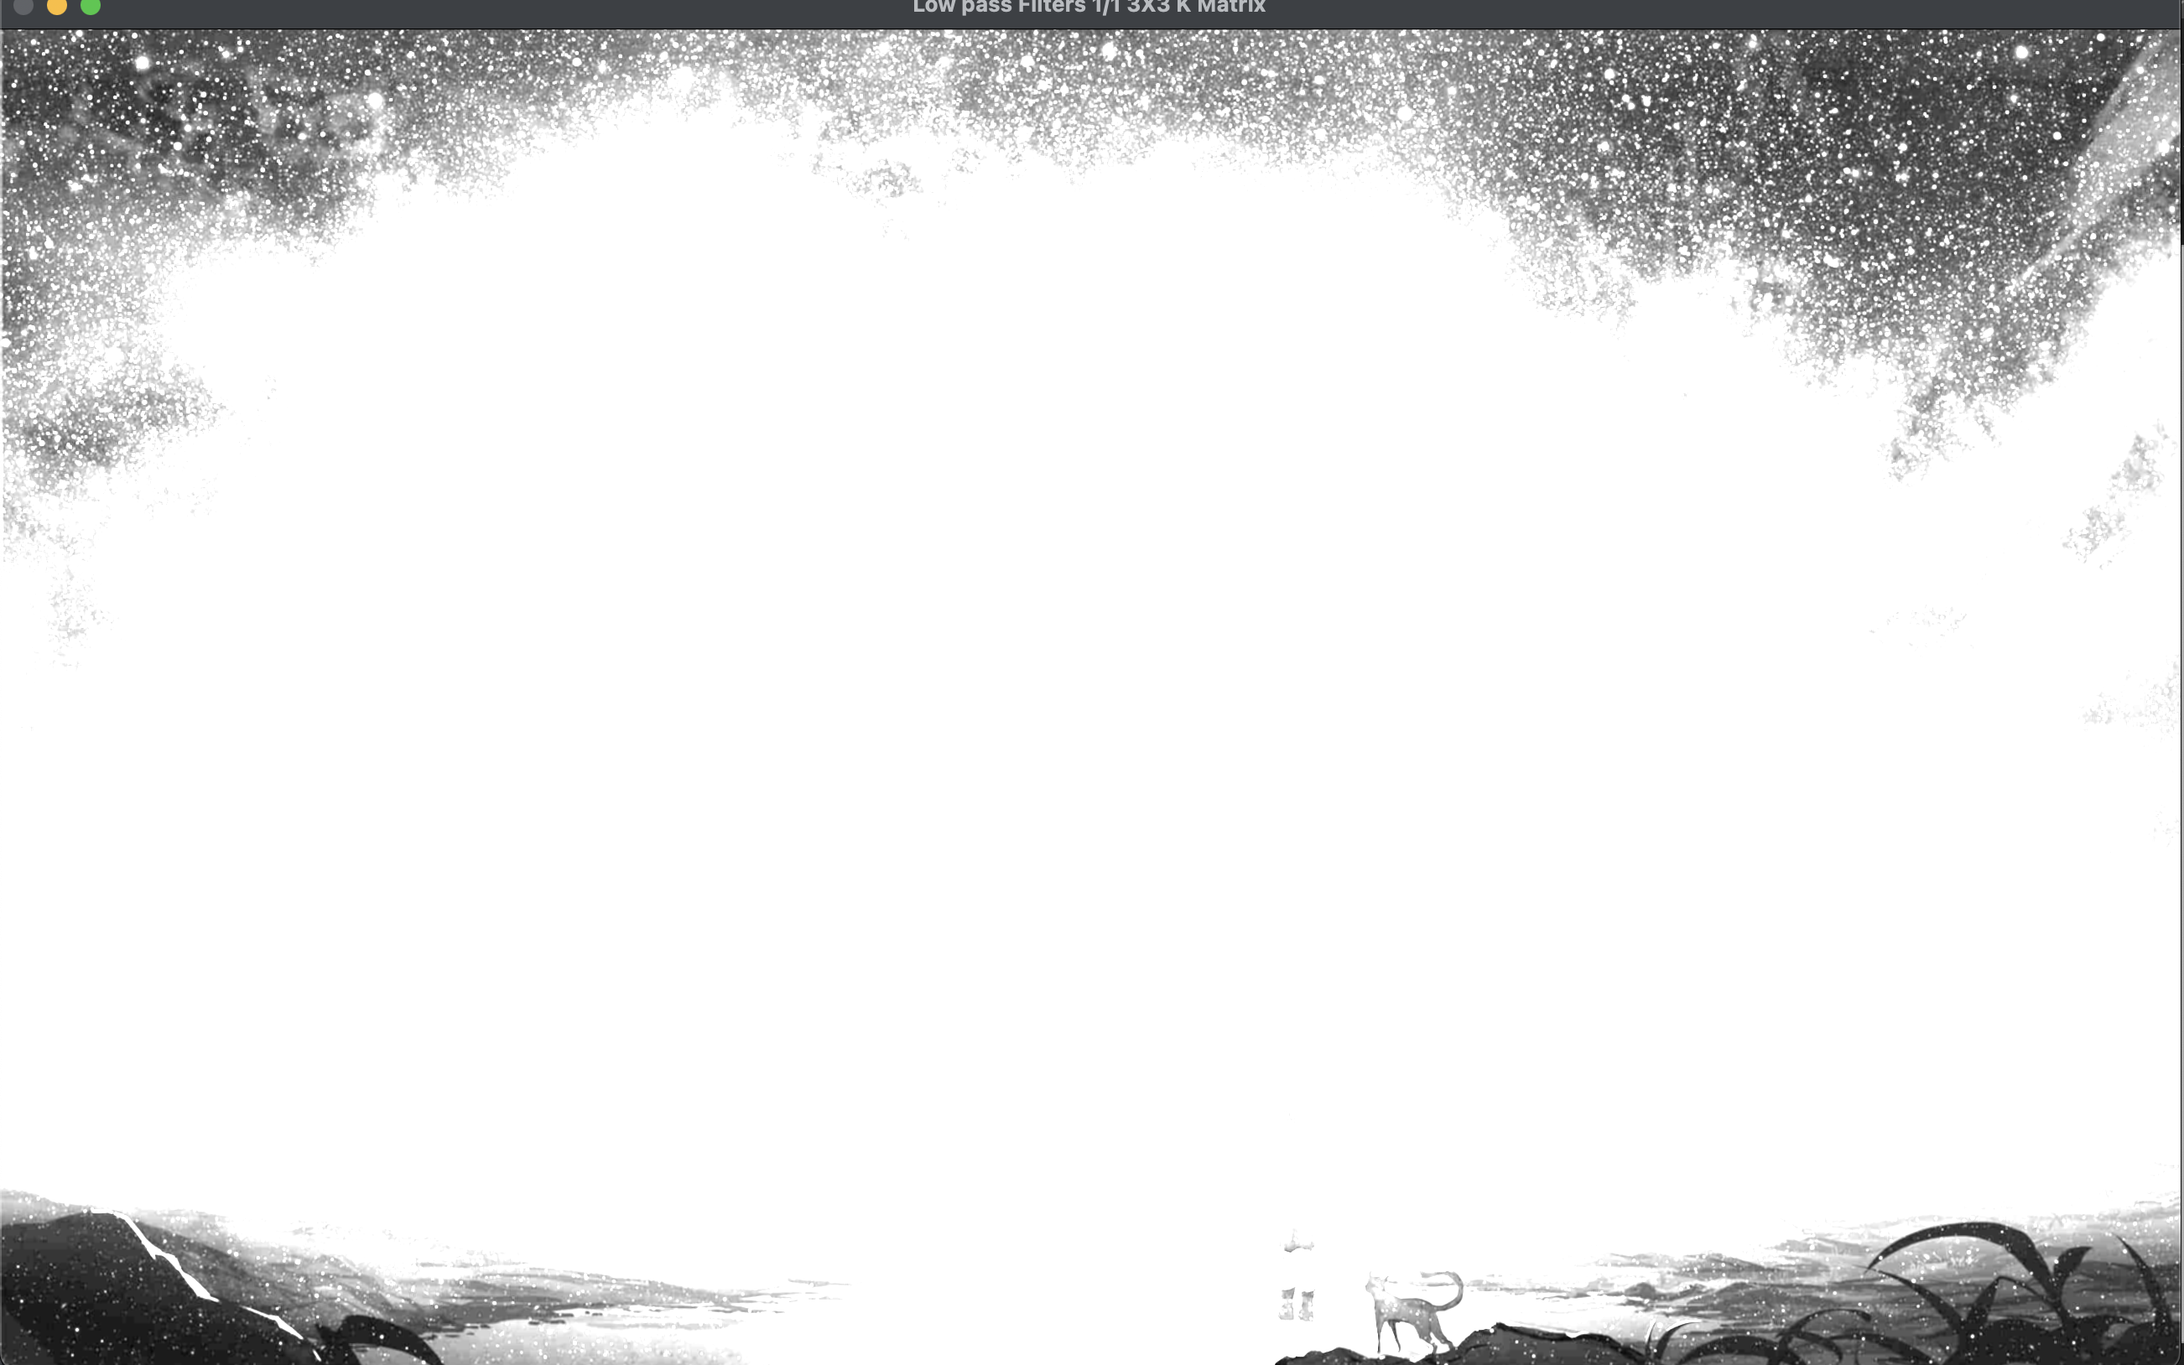
OUTPUT-:

Slide 16
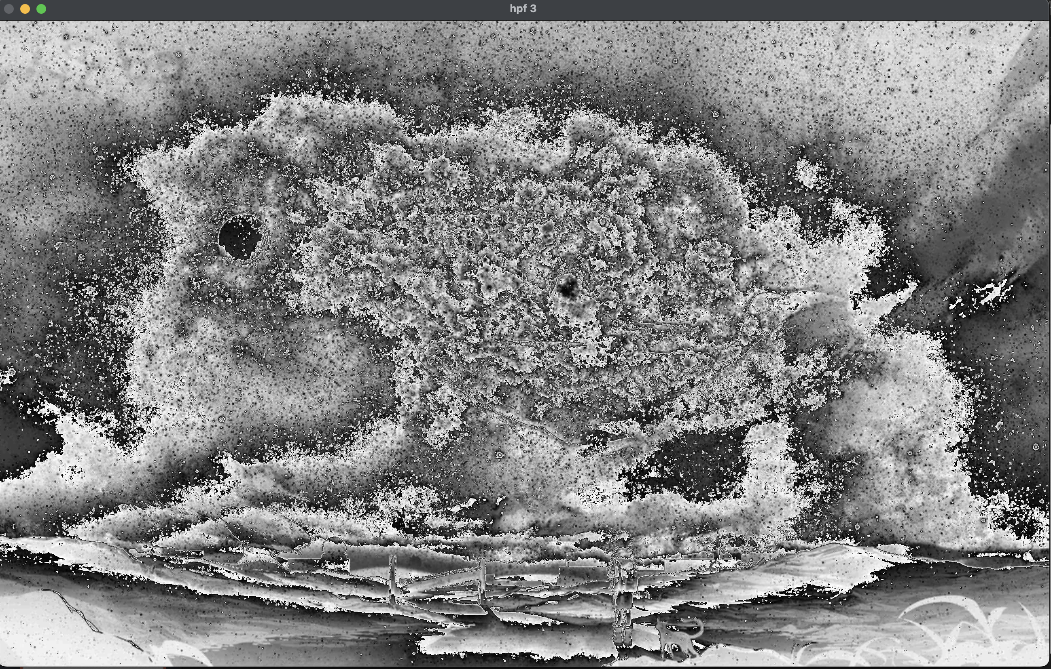
OUTPUT-:

Slide 17
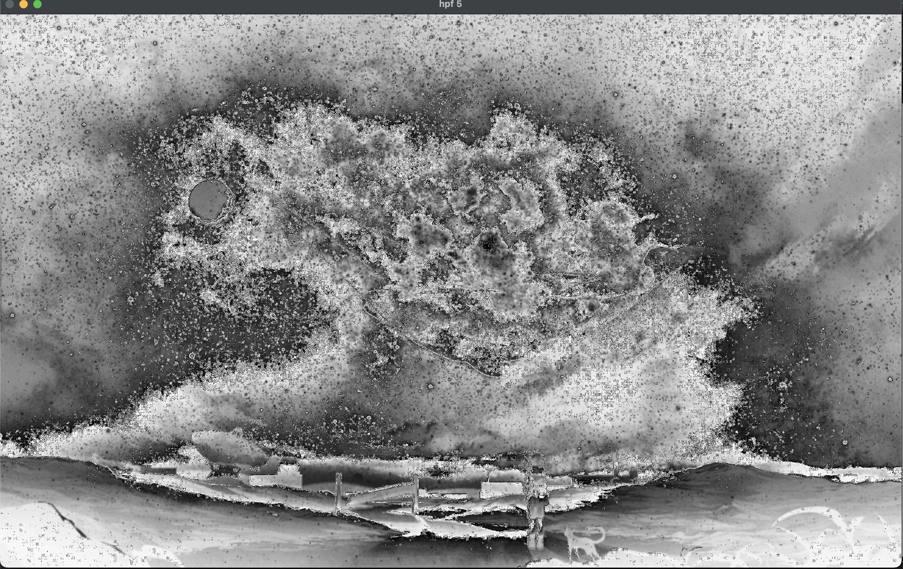
OUTPUT-:

Slide 18
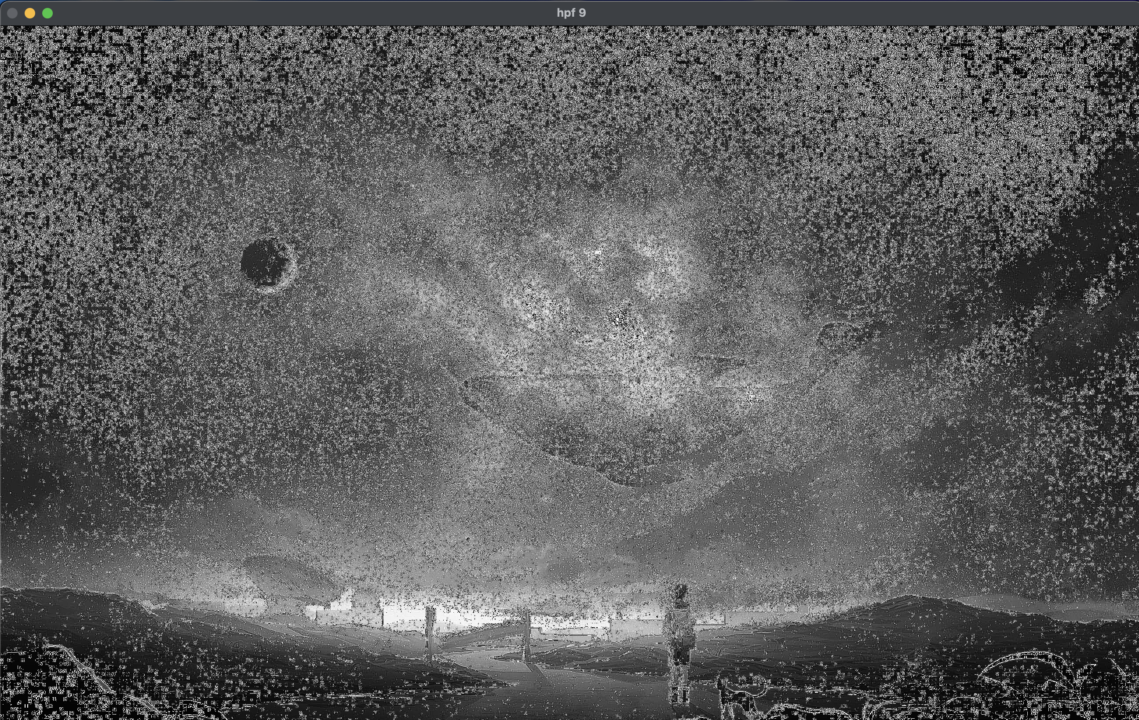
OUTPUT-:

Slide 19
THANK YOU You can find the code at -: https://github.com/Baka-14/Digital_Image_processing

